Slide 1
Hydro-Meteorological Network of Central Water Commission
N. K. Manglik
Director

Slide 2
Hydro-Meteorological Data Observation
Hydro-meteorological observations could be broadly defined as the scientific way for collection of flow data at a specific location along the river including selected meteorological parameters
The reliability of the data is an important attribute for assessing the water resources in terms of quantity, quality and distribution in time and space .

Slide 3
Hydro-Meteorological Data Observation PURPOSE
Assessment of basin wise water availability and management
Planning and design of water resources projects
Study of climate change
Flood forecast
Flood mitigation
Formulating National Water Policy

Slide 4
Hydro-Meteorological Data Observation PURPOSE
Reservoir inflow forecasting
Water quality assessment
Sediment assessment
Morphological studies
Assessment of navigational potential for inland waterways
Resolving inter-state or international water disputes

Slide 5
Hydro-Meteorological Data Observation PURPOSE
Study of the effect of nature and human interference
On surface water availability and its distribution
Research purposes
Estimation of periodical flow distribution during various seasons
Other purpose

Slide 6
Hydro-Meteorological Observation Parameters
Water Level (Gauge)
Discharge or Flow
Water Quality
Silt
Selected Meteorological parameters including snow observations

Slide 7
Hydro-Meteorological Observation NETWORK
Hydrological network optimization is a slow and evolutionary process, starting with a minimum number of stations, and increasing gradually (as necessary) until an optimum network is attained. An optimum network is achieved when the amount and quality of data collected and information processed is economically justifiable and it meets the users’ needs

Slide 8
Hydro-Meteorological Observation NETWORK
Hydro-meteorological observation network in a basin depends on:
Purpose or objective
Terrain or Physiographic region in the basin

Slide 9
Minimum hydro-meteorological stations WMO Guidelines
S N | Physio-graphic Region | Minimum density (area in km² per station)
 |  | Precipitation Station |  | Evaporation Station | Stream flow Station | Sediment discharge and sedimentation | Water Temperature (Water Quality Station)
 |  | Non – recording | Recording
1. | Coastal | 900 | 9,000 | 50,000 | 2,750 | 18,300 | 55,000
2. | Mountainous | 250 | 2,500 | 50,000 | 1,000 | 6,700 | 20,000
3. | Interior Plains | 575 | 5,750 | 50,000 | 1,875 | 12,500 | 37,500
4. | Hilly/ Undulating | 575 | 5,750 | 50,000 | 1,875 | 12,500 | 47,500
5. | Small islands | 25 | 2520 | 50,000 | 300 | 2,000 | 6,000
6. | Polar/arid | 10,000 | 100,000 | 100,000 | 20,000 | 200,000 | 200,000

Slide 10
CLASSIFICATION OF HYDROLOGICAL OBSERVATION STATIONS
Primary stations
Key gauging stations, Principal stations
Maintained on long term basis to generate representative flow series
Secondary stations
Short duration stations
Period enough to establish the flow characteristics of the river or stream .
Special purpose stations
Specific purpose stations or project stations or temporary stations
Discontinued when the purpose is served.
Fulfillment of legal agreement between co-basin states.
The primary as well as the secondary stations also many a times serve as special purpose stations.

Slide 11
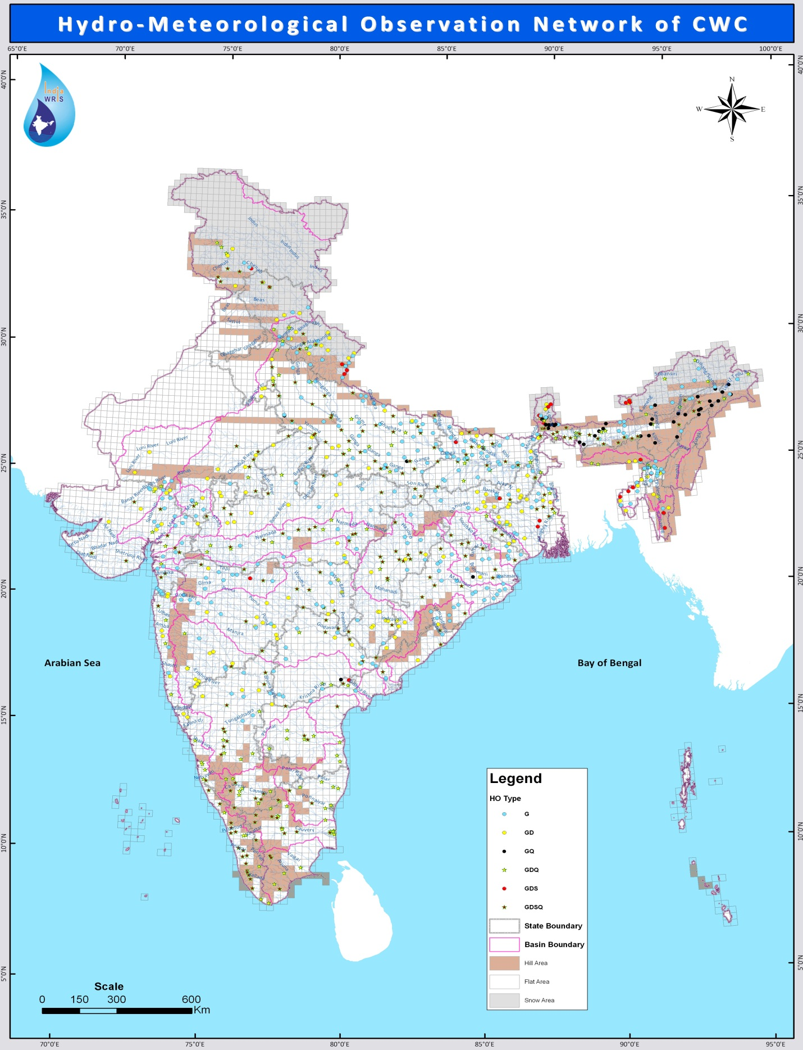
Hydro-Meteorological Station of CWC (878)

Slide 16
EXISTING TELEMETRY
Sensors | No of sites
 | MCO | NTBO | UGBO | LGBO | IBO | KGBO | BBBO | MERO | YBO | TOTAL
A-type- Rainfall | 3 | 16 | 7 | 4 |  | 18 | 13 | 9 | 9 | 30
B-type -Rainfall & River Water Level | 1 | 40 | 38 | 24 | 4 | 86 | 20 | 59 | 45 | 127
C-Type -Rainfall & Reservoir Water Level |  | 17 |  | 8 |  | - | - | 2 | - | 6
D-type -Rainfall, Water Level, Temperature, Humidity, Evaporation, Wind Speed, Wind Direction, Solar Radiation |  | 3 |  | 2 |  | - | 2 | 9 | 6 | 5
TOTAL | 4 | 76 | 45 | 38 | 4 | 104 | 35 | 79 | 60 | 445

Slide 17
Existing Hydrological Observation Stations of CWC- State wise
S. N. | State | G | GD | GDQ | GDS | GDSQ | GQ | Grand Total
1 | Andhra Pradesh | 6 | 2 | 10 | 0 | 6 | 1 | 25
2 | Arunachal Pradesh | 12 | 4 | 2 | 2 | 0 | 4 | 24
3 | Assam | 28 | 2 | 7 | 3 | 16 | 17 | 73
4 | Bihar | 34 | 4 | 4 | 1 | 14 | 0 | 57
5 | Chhattisgarh | 8 | 8 | 1 | 0 | 15 | 0 | 32
6 | D.& NH | 4 | 0 | 0 | 0 | 0 | 0 | 4
7 | Delhi | 0 | 1 | 1 | 0 | 1 | 0 | 3
8 | Goa | 0 | 2 | 0 | 0 | 0 | 0 | 2
9 | Gujarat | 20 | 8 | 5 | 0 | 9 | 0 | 42
10 | Haryana | 1 | 3 | 0 | 0 | 1 | 0 | 5
11 | Himachal Pradesh | 5 | 4 | 2 | 1 | 2 | 0 | 14
12 | Jammu & Kashmir | 3 | 4 | 3 | 1 | 4 | 0 | 15
13 | Jharkhand | 8 | 11 | 3 | 0 | 6 | 1 | 29

Slide 18
Existing Hydrological Observation Stations of CWC- State wise
S. N. | State | G | GD | GDQ | GDS | GDSQ | GQ | Grand Total
14 | Karnataka | 8 | 4 | 18 | 0 | 15 | 0 | 45
15 | Kerala | 0 | 0 | 3 | 0 | 18 | 0 | 21
16 | Madhya Pradesh | 8 | 14 | 10 | 0 | 18 | 0 | 50
17 | Maharashtra | 22 | 21 | 5 | 2 | 18 | 1 | 69
18 | Manipur | 1 | 0 | 0 | 0 | 0 | 0 | 1
19 | Meghalaya | 1 | 0 | 5 | 1 | 0 | 0 | 7
20 | Mizoram | 2 | 2 | 0 | 3 | 0 | 0 | 7
21 | Odisha | 29 | 8 | 0 | 0 | 16 | 0 | 53
22 | Pondicherry | 0 | 0 | 3 | 0 | 0 | 0 | 3
23 | Rajasthan | 5 | 9 | 3 | 0 | 7 | 0 | 24
24 | Sikkim | 6 | 2 | 0 | 7 | 0 | 0 | 15
25 | Tamilnadu | 0 | 0 | 20 | 0 | 15 | 0 | 35
26 | Tripura | 4 | 4 | 0 | 5 | 0 | 0 | 13

Slide 19
Existing Hydrological Observation Stations of CWC- State wise
S. No | State | G | GD | GDQ | GDS | GDSQ | GQ | Grand Total
27 | Telengana | 13 | 4 | 3 | 0 | 5 | 0 | 25
28 | Uttar Pradesh | 36 | 10 | 13 | 0 | 32 | 2 | 93
29 | Uttrakhand | 12 | 10 | 3 | 5 | 4 | 0 | 34
30 | West Bengal | 19 | 13 | 6 | 2 | 18 | 0 | 58
 | Grand Total | 295 | 154 | 131 | 33 | 239 | 26 | 878

Slide 20
Existing Hydrological Observation Stations of CWC- Basin- wise
S. N | Name of Basin | G | GD | GDQ | GDS | GDSQ | GQ | Grand Total
1. | Brahmani-Baitarni Basin | 6 | 1 | 0 | 0 | 8 | 0 | 15
2. | Cauvery Basin | 0 | 0 | 19 | 0 | 15 | 0 | 34
3. | East Flowing Rivers between Mahanadi and Pennar | 7 | 2 | 0 | 0 | 4 | 0 | 13
4. | East Flowing Rivers between Pennar and Kanyakumari | 0 | 0 | 12 | 0 | 5 | 0 | 17
5. | Ganga/Brahmaputra/Meghna/Barak Basin | 164 | 81 | 49 | 29 | 101 | 24 | 445
6. | Godavari Basin | 25 | 26 | 2 | 1 | 22 | 1 | 77
7. | Indus Basin | 7 | 8 | 3 | 2 | 6 | 0 | 26
8. | Krishna Basin | 16 | 13 | 10 | 0 | 13 | 1 | 53
9. | Mahanadi Basin | 18 | 3 | 1 | 0 | 17 | 0 | 39
10. | Mahi Basin | 6 | 2 | 1 | 0 | 3 | 0 | 12

Slide 21
Existing Hydrological Observation Stations of CWC- Basin- wise
Sn | Name of Basin | G | GD | GDQ | GDS | GDSQ | GQ | G. Total
11. | Narmada Basin | 8 | 0 | 7 | 0 | 11 | 0 | 26
12. | Pennar Basin | 0 | 0 | 6 | 0 | 2 | 0 | 8
13. | Sabarmati Basin | 7 | 3 | 2 | 0 | 1 | 0 | 13
14. | Subernarekha Basin | 5 | 2 | 1 | 0 | 4 | 0 | 12
15. | Tapi Basin | 12 | 1 | 1 | 1 | 3 | 0 | 18
16. | WFR from Tapi to Tadri | 8 | 7 | 4 | 0 | 3 | 0 | 22
17. | WFR from Tadri to Kanyakumari | 0 | 0 | 11 | 0 | 18 | 0 | 29
18. | WFR of Kutchh & Saurashtra | 4 | 5 | 2 | 0 | 3 | 0 | 14
19. | Area of Inland Drainage in Rajasthan Desert | 0 | 0 | 0 | 0 | 0 | 0 | 0
20. | Minor Rivers draining Myanmar (Burma) and Bangladesh | 2 | 0 | 0 | 3 | 0 | 0 | 5
 | Grand Total | 295 | 154 | 131 | 33 | 239 | 26 | 878

Slide 22
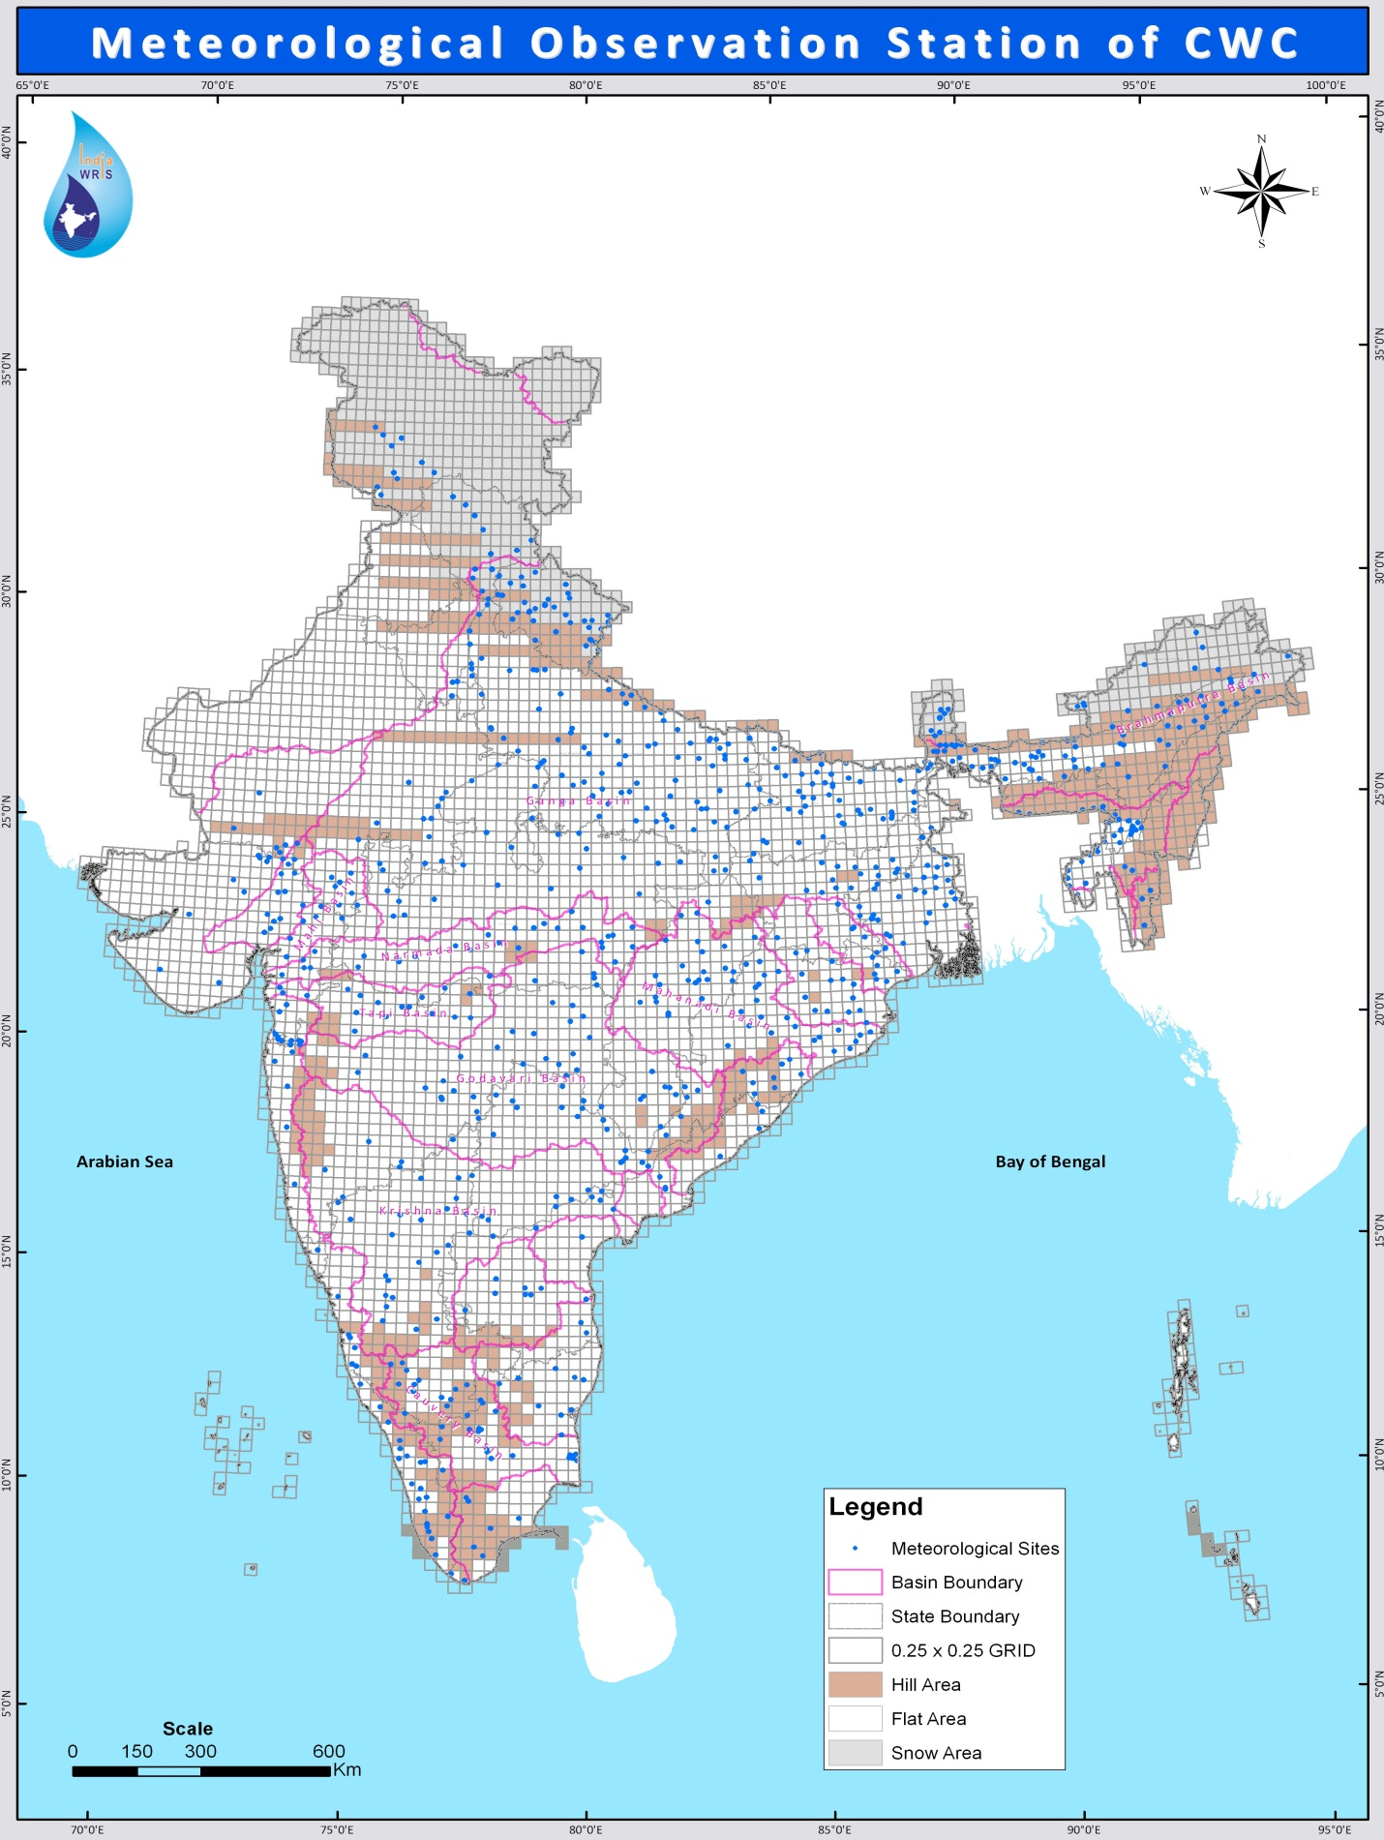
Meteorological Station of CWC

Slide 25
Meteorological Observation Stations-Basin wise
S. No | Total | Rf | Rf(T) | Mt | Hu | Ss | Pe | Wv | Sg | Ar | Gwl | Fcs | FF
1. | Brahmani - Baitarni Basin
 | 15 | 13 | 0 | 14 | 0 | 0 | 0 | 0 | 0 | 0 | 0 | 1 | 0
2. | Cauvery Basin
 | 32 | 23 | 0 | 29 | 7 | 1 | 10 | 26 | 0 | 6 | 0 | 3 | 0
3. | East Flowing Rivers between Mahanadi and Pennar
 | 13 | 13 | 0 | 12 | 0 | 0 | 0 | 0 | 0 | 0 | 0 | 0 | 0
4. | East Flowing Rivers between Pennar to Kanyakumari
 | 17 | 12 | 0 | 15 | 0 | 0 | 2 | 13 | 0 | 0 | 0 | 2 | 3
5. | Ganga-Brahamaputra-Meghna/Barak
 | 385 | 334 | 8 | 215 | 9 | 0 | 9 | 23 | 1 | 33 | 3 | 2 | 4
6. | Godavari Basin
 | 68 | 58 | 39 | 24 | 0 | 0 | 0 | 0 | 0 | 8 | 0 | 2 | 0

Slide 26
Meteorological Observation Stations-Basin wise
S. No | Total |  | Rf | Rf(T) | Mt | Hu | Ss | Pe | Wv | Sg | Ar | Gwl | Fcs | FF
7. | Indus Basin
 | 15 |  | 13 | 0 | 6 | 4 | 0 | 0 | 3 | 6 | 0 | 0 | 0 | 0
8. | Krishna Basin
 | 38 |  | 29 | 23 | 8 | 0 | 0 | 4 | 6 | 0 | 9 | 0 | 3 | 0
9. | Mahanadi Basin
 | 39 |  | 38 | 0 | 31 | 0 | 0 | 1 | 1 | 0 | 0 | 0 | 1 | 0
10. | Mahi Basin
 | 13 | 4 |  | 0 | 2 | 1 | 1 | 1 | 1 | 0 | 0 | 0 | 0 | 0
11. | Narmada Basin
 | 24 |  | 24 | 0 | 16 | 14 | 0 | 9 | 15 | 0 | 0 | 0 | 0 | 0
12. | Pennar Basin
 | 8 |  | 8 | 0 | 8 | 3 | 0 | 1 | 7 | 0 | 1 | 0 | 0 | 0

Slide 27
Meteorological Observation Stations-Basin wise
S. No | Total | Rf | Rf (T) | Mt | Hu | Ss | Pe | Wv | Sg | Ar | Gwl | Fcs | FF
13. | Sabarmati Basin
 | 13 | 7 | 0 | 6 | 0 | 0 | 0 | 0 | 0 | 0 | 0 | 0 | 0
14. | Subarnarekha & Burhabalang Basin
 | 12 | 12 | 0 | 11 | 0 | 0 | 0 | 0 | 0 | 0 | 0 | 0 | 0
15. | Tapi Basin
 | 17 | 17 | 0 | 0 | 0 | 0 | 0 | 0 | 0 | 0 | 0 | 2 | 0
16. | West Flowing Rivers from Tadri to Kanyakumari
 | 29 | 15 | 0 | 27 | 0 | 0 | 4 | 25 | 0 | 0 | 0 | 2 | 0
17. | West Flowing Rivers from Tapi to Tadri
 | 14 | 14 | 0 | 0 | 0 | 0 | 0 | 0 | 0 | 1 | 0 | 0 | 0
18. | West Flowing Rivers of Kutchh & Saurashtra
 | 14 | 4 | 0 | 11 | 0 | 0 | 0 | 7 | 0 | 0 | 0 | 0 | 0

Slide 28
Meteorological Observation Stations-Basin wise
S. No | Total | Rf | Rf (T) | Mt | Hu | Ss | Pe | Wv | Sg | Ar | Gwl | Fcs | FF
19. | Minor Rivers draining in to Myanmar (Burma) and Bangladesh
 | 0 | 0 | 0 | 0 | 0 | 0 | 0 | 0 | 0 | 0 | 0 | 0 | 0
20. | Area of Inland Drainage in Rajasthan Desert
 | 0 | 0 | 0 | 0 | 0 | 0 | 0 | 0 | 0 | 0 | 0 | 0 | 0
 | Grand Total
 | 776 | 652 | 70 | 439 | 38 | 2 | 41 | 129 | 9 | 57 | 3 | 18 | 7

Slide 29
Meteorological Observation Stations - State-wise
S.No. | Total | Rf | Rf(T) | Mt | Hu | Ss | Pe | Wv | Sg | Ar | Fcs | FF
1. | Andhra Pradesh
 | 44 | 37 | 20 | 14 | 3 | 0 | 1 | 9 | 0 | 7 | 0 | 3
2. | Arunachal Pradesh
 | 17 | 13 | 5 | 5 | 3 | 0 | 3 | 2 | 1 | 0 | 0 | 1
3. | Assam
 | 63 | 56 | 3 | 20 | 2 | 0 | 2 | 6 | 0 | 4 | 2 | 1
4. | Bihar
 | 48 | 40 | 0 | 26 | 0 | 0 | 0 | 0 | 0 | 0 | 1 | 0
5. | Chhattisgarh
 | 22 | 29 | 8 | 17 | 0 | 0 | 1 | 1 | 0 | 1 | 0 | 1
6. | Dadra & Nagar Haveli
 | 3 | 3 | 0 | 0 | 0 | 0 | 0 | 0 | 0 | 0 | 0 | 0
7. | Delhi
 | 3 | 3 | 0 | 2 | 0 | 0 | 0 | 2 | 0 | 0 | 0 | 0
8. | Goa
 | 1 | 1 | 0 | 0 | 0 | 0 | 0 | 0 | 0 | 0 | 0 | 0

Slide 30
Meteorological Observation Stations - State-wise
S.No. | Total | Rf | Rft | Mt | Hu | Ss | Pe | Wv | Sg | Ar | Fcs | FF
9. | Gujarat
 | 41 | 26 | 0 | 16 | 1 | 1 | 1 | 6 | 0 | 0 | 0 | 1
10. | Haryana
 | 5 | 5 | 0 | 3 | 0 | 0 | 0 | 0 | 0 | 0 | 0 | 0
11. | Himachal Pradesh
 | 9 | 7 | 0 | 6 | 4 | 0 | 0 | 0 | 2 | 0 | 0 | 0
12. | J&K
 | 9 | 9 | 0 | 3 | 0 | 0 | 0 | 3 | 4 | 0 | 0 | 0
13. | Jharkhand
 | 23 | 21 | 0 | 8 | 0 | 0 | 0 | 0 | 0 | 0 | 0 | 0
14. | Karnataka
 | 37 | 32 | 11 | 25 | 0 | 0 | 13 | 18 | 0 | 11 | 0 | 0
15. | Kerala
 | 21 | 9 | 0 | 20 | 0 | 0 | 0 | 20 | 0 | 0 | 0 | 1
16. | Madhya Pradesh
 | 48 | 46 | 0 | 39 | 14 | 0 | 9 | 16 | 0 | 4 | 0 | 0

Slide 31
Meteorological Observation Stations - State-wise
S.No. | No. of Met. Stations | Rf | Rf(T) | Mt | Hu | Ss | Pe | Wv | Sg | Ar | Fcs | FF
17. | Maharashtra
 | 54 | 44 | 18 | 18 | 0 | 0 | 0 | 0 | 0 | 5 | 0 | 3
18. | Manipur
 | 1 | 1 | 0 | 0 | 0 | 0 | 0 | 0 | 0 | 0 | 0 | 0
19. | Meghalaya
 | 6 | 6 | 0 | 6 | 0 | 0 | 1 | 0 | 0 | 0 | 0 | 0
20. | Mizoram
 | 7 | 7 | 0 | 4 | 0 | 0 | 1 | 1 | 0 | 0 | 0 | 0
21. | Orissa
 | 53 | 51 | 5 | 42 | 0 | 0 | 0 | 0 | 0 | 0 | 0 | 1
22. | Pondicherry
 | 3 | 1 | 0 | 3 | 2 | 0 | 0 | 3 | 0 | 0 | 0 | 0
23. | Rajasthan
 | 24 | 18 | 0 | 19 | 0 | 0 | 0 | 3 | 0 | 0 | 0 | 0
24. | Sikkim
 | 11 | 11 | 0 | 0 | 0 | 0 | 0 | 0 | 2 | 0 | 0 | 0

Slide 32
Meteorological Observation Stations - State-wise
S.No. | Total | Rf | Rf(T) | Mt | Hu | Ss | Pe | Wv | Sg | Ar | Fcs | FF
25. | Tamilnadu
 | 35 | 24 | 0 | 29 | 5 | 1 | 7 | 27 | 0 | 1 | 0 | 6
26. | Tripura
 | 12 | 12 | 0 | 9 | 0 | 0 | 0 | 0 | 0 | 0 | 0 | 0
27. | Uttar Pradesh
 | 84 | 84 | 0 | 53 | 0 | 0 | 0 | 0 | 0 | 16 | 0 | 0
28. | Uttarakhand
 | 30 | 26 | 0 | 19 | 4 | 0 | 2 | 0 | 0 | 0 | 0 | 0
29 | West Bengal
 | 54 | 30 | 0 | 33 | 0 | 0 | 0 | 12 | 0 | 8 | 0 | 0
Grand Total | 776 | 652 | 70 | 439 | 38 | 2 | 41 | 129 | 9 | 57 | 3 | 18

Slide 34
Exclusive Meteorological Observation Stations Under CWC-Basin-wise
S. No. | Total | Rf | Rf(T) | Mt | Hu | Ss | Pe | Wv | Sg | Ar | Gwl | Fcs | FF
1 | Brahmani - Baitarni Basin
 | 1 | 1 | 0 | 0 | 0 | 0 | 0 | 0 | 0 | 0 | 0 | 0 | 0
2 | Ganga-Brahamaputra-Meghna/Barak
 | 24 | 11 | 11 | 6 | 6 | 0 | 1 | 1 | 8 | 0 | 0 | 0
3 | Godavari Basin
 | 3 | 1 | 2 | 0 | 0 | 0 | 0 | 0 | 0 | 0 | 0 | 0
4 | Indus Basin
 | 22 | 21 | 0 | 2 | 2 | 0 | 0 | 0 | 19 | 6 | 0 | 0
5 | Krishna Basin
 | 9 | 0 | 9 | 0 | 0 | 0 | 0 | 0 | 0 | 0 | 0 | 0

Slide 35
Exclusive Meteorological Observation Stations Under CWC-Basin-wise
S. No. | Total | Rf | Rf(T) | Mt | Hu | Ss | Pe | Wv | Sg | Ar | Fcs | FF
6 | Mahanadi Basin
 | 5 | 5 | 0 | 1 | 0 | 0 | 0 | 1 | 0 | 0 | 0 | 0
7 | Mahi Basin
 | 0 | 0 | 0 | 0 | 0 | 0 | 0 | 0 | 0 | 0 | 0 | 0
8 | Narmada Basin
 | 2 | 2 | 0 | 1 | 1 | 0 | 0 | 0 | 0 | 0 | 0 | 0
9 | Tapi Basin
 | 7 | 7 | 0 | 0 | 0 | 0 | 0 | 0 | 0 | 0 | 0 | 0
10 | West Flowing Rivers from Tadri to Kanyakumari
 | 3 | 3 | 0 | 0 | 0 | 0 | 0 | 0 | 0 | 0 | 0 | 0
G. Total | 76 | 51 | 0 | 10 | 9 | 0 | 1 | 2 | 27 | 6 | 0 | 0

Slide 37
Exclusive Meteorological Observation Stations Under CWC- State-wise
S. No. | Total | Rf | Rf(T) | Mt | Hu | Ss | Pe | Wv | Sg | Ar | Fcs | FF
1. | Andhra Pradesh
 | 4 | 0 | 4 | 0 | 0 | 0 | 0 | 0 | 0 | 0 | 0 | 0
2. | Arunachal Pradesh
 | 8 | 0 | 8 | 0 | 0 | 0 | 0 | 0 | 0 | 0 | 0 | 0
3. | Assam
 | 3 | 0 | 3 | 0 | 0 | 0 | 0 | 0 | 0 | 0 | 0 | 0
4. | Bihar
 | 0 | 0 | 0 | 0 | 0 | 0 | 0 | 0 | 0 | 0 | 0 | 0
5. | Chhattisgarh
 | 3 | 3 | 0 | 0 | 0 | 0 | 0 | 0 | 0 | 0 | 0 | 0

Slide 38
Exclusive Meteorological Observation Stations Under CWC- State-wise
Sn | Total | Rf | Rf(T) | Mt | Hu | Ss | Pe | Wv | Sg | Ar | Fcs | FF
6. | Dadra & Nagar Haveli
 | 0 | 0 | 0 | 0 | 0 | 0 | 0 | 0 | 0 | 0 | 0 | 0
7. | Delhi
 | 0 | 0 | 0 | 0 | 0 | 0 | 0 | 0 | 0 | 0 | 0 | 0
8. | Gujarat
 | 1 | 1 | 0 | 0 | 0 | 0 | 0 | 0 | 0 | 0 | 0 | 0
9. | Himachal Pradesh
 | 7 | 5 | 0 | 5 | 5 | 0 | 1 | 1 | 7 | 2 | 0 | 0
10. | Jammu & Kashmir
 | 18 | 18 | 0 | 0 | 0 | 0 | 0 | 0 | 15 | 4 | 0 | 0
11. | Karnataka
 | 5 | 5 | 0 | 0 | 0 | 0 | 0 | 0 | 0 | 0 | 0 | 0
12. | Madhya Pradesh
 | 2 | 2 | 0 | 1 | 1 | 0 | 0 | 0 | 0 | 0 | 0 | 0

Slide 39
Exclusive Meteorological Observation Stations Under CWC- State-wise
S. No. | Total | Rf | Rf(T) | Mt | Hu | Ss | Pe | Wv | Sg | Ar | Fcs | FF
13. | Maharashtra
 | 12 | 10 | 2 | 0 | 0 | 0 | 0 | 0 | 0 | 0 | 0 | 0
14. | Orissa
 | 3 | 3 | 0 | 0 | 0 | 0 | 1 | 1 | 0 | 0 | 0 | 0
15. | Uttarakhand
 | 10 | 9 | 0 | 3 | 3 | 0 | 0 | 0 | 5 | 0 | 0 | 0
G. Total | 76 | 51 | 0 | 10 | 9 | 0 | 1 | 2 | 27 | 6 | 0 | 0

Slide 40
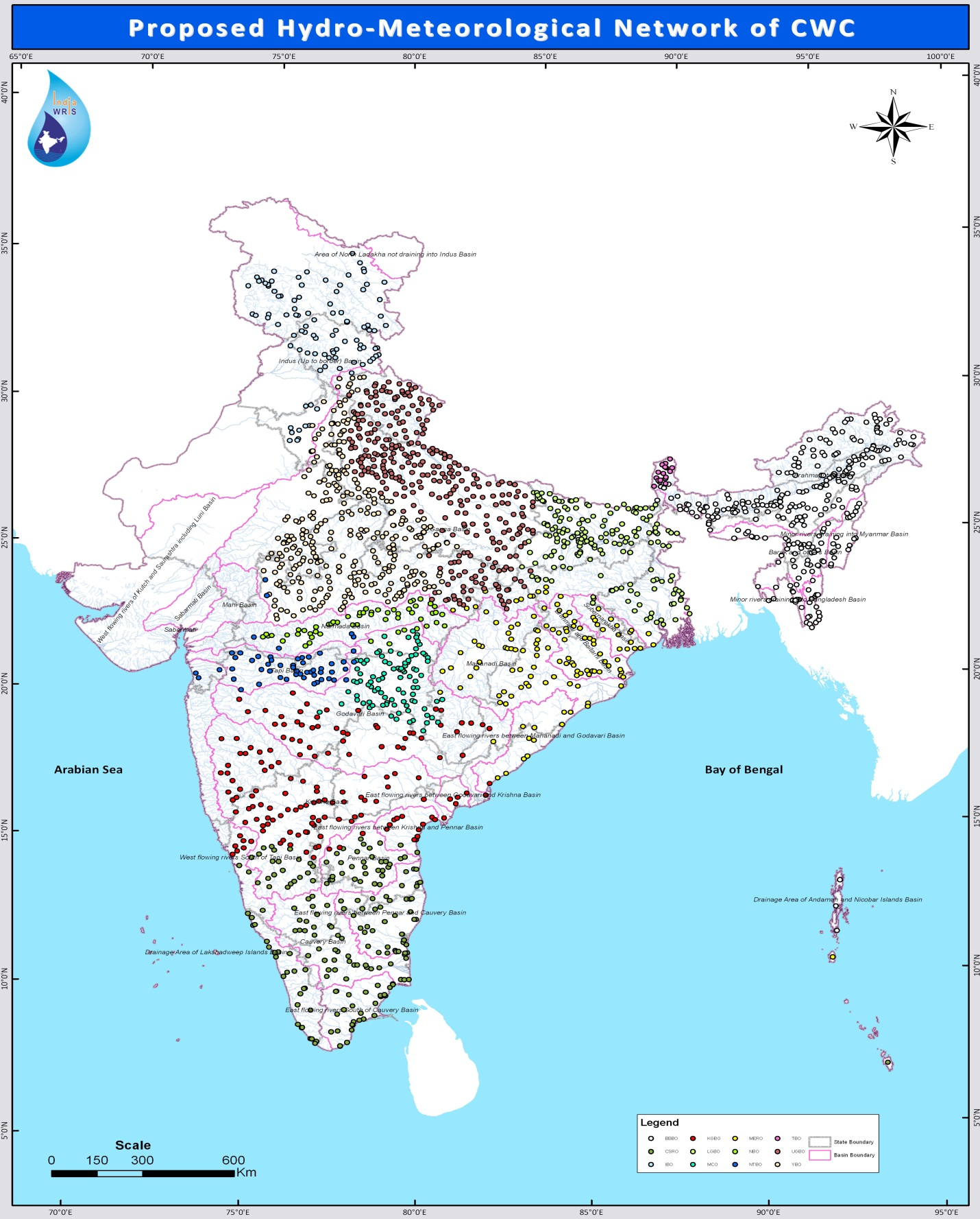
Proposed Hydro-Meteorological Station (1917)

Slide 41
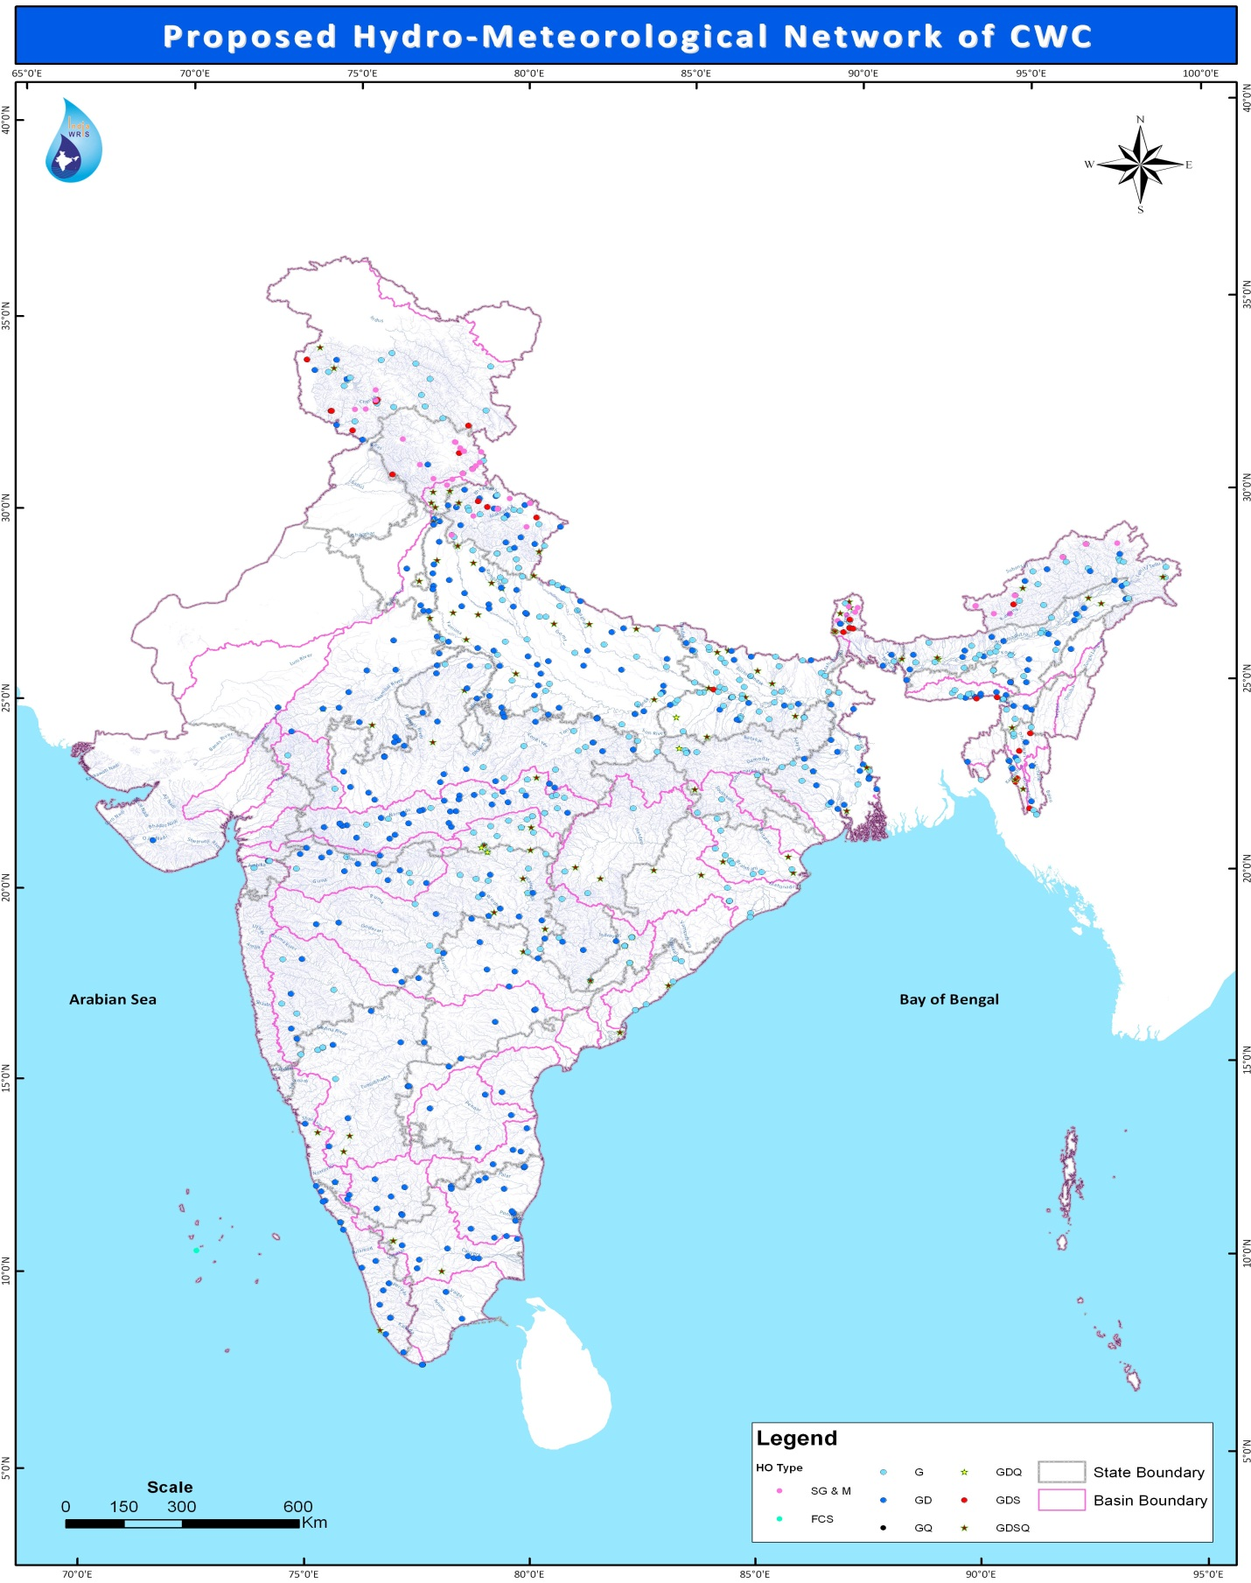
Proposed Hydro-Meteorological Station (800) in 12th Plan

Slide 43
Proposed 800 HO sites during 12th Plan
States | FCS | G | GD | GDQ | GDS | GDSQ | SG & M | Grand Total
Andhra Pradesh |  | 6 | 25 |  |  | 4 |  | 35
Arunachal Pradesh |  | 12 | 7 |  | 2 | 2 | 12 | 35
Assam |  | 21 | 22 |  |  | 6 |  | 49
Bihar |  | 39 | 14 | 1 | 1 | 8 |  | 63
Chhattisgarh |  | 6 | 4 |  |  | 3 |  | 13
Delhi |  |  |  |  |  | 1 |  | 1
Gujarat |  | 3 | 2 |  |  |  |  | 5
Haryana |  |  | 7 |  |  | 1 |  | 8
Himachal Pradesh |  | 2 | 3 |  | 3 | 3 | 15 | 26
Jammu & Kashmir |  | 16 | 5 |  | 6 | 2 | 4 | 33
Jharkhand |  | 5 | 1 | 1 |  |  |  | 7
Karnataka |  | 3 | 22 |  |  | 4 |  | 29
Kerala |  |  | 16 |  |  | 2 |  | 18
Lakshadweep | 1 |  |  |  |  |  |  | 1

Slide 44
Proposed 800 HO sites during 12th Plan
States | G | GD | GDQ | GDS | GDSQ | SG & M | Grand Total
Madhya Pradesh | 36 | 51 | 1 |  | 6 |  | 94
Maharashtra | 21 | 25 | 1 |  | 5 |  | 52
Meghalaya | 9 | 10 |  | 3 |  |  | 22
Mizoram | 9 | 6 |  | 5 | 3 |  | 23
Nagaland |  | 1 |  |  |  |  | 1
Odisha | 28 | 2 |  |  | 12 |  | 42
Rajasthan | 1 | 18 |  |  | 2 |  | 21
Sikkim | 3 | 2 |  | 6 | 4 | 9 | 24
Tamil Nadu |  | 21 |  |  | 3 |  | 24
Tripura | 1 | 1 |  |  |  |  | 2
Uttar Pradesh | 32 | 45 |  |  | 15 |  | 92
Uttarakhand | 18 | 16 |  | 3 | 3 | 7 | 47
West Bengal | 11 | 17 |  | 1 | 4 |  | 33
Grand Total | 282 | 343 | 4 | 30 | 93 | 47 | 800

Slide 45
Organization wise proposed 800 HO sites
ORG. | FCS | G | GD | GDQ | GDS | GDSQ | SG & M | G. Total
BBBO |  | 53 | 49 |  | 10 | 11 | 12 | 135
CSRO | 1 |  | 65 |  |  | 9 |  | 75
IBO |  | 18 | 8 |  | 9 | 2 | 18 | 55
KGBO |  | 10 | 31 |  |  | 3 |  | 44
LGBO |  | 53 | 29 | 2 | 1 | 12 |  | 97
MCO |  | 20 | 10 | 2 |  | 8 |  | 40
MERO |  | 39 |  |  |  | 16 |  | 55
NBO |  | 12 | 32 |  |  | 1 |  | 45
NTBO |  | 10 | 15 |  |  |  |  | 25
TBO |  | 3 | 2 |  | 7 | 4 | 9 | 25
UGBO |  | 53 | 45 |  | 3 | 11 | 7 | 119
YBO |  | 11 | 57 |  |  | 16 | 1 | 85
Grand Total | 1 | 282 | 343 | 4 | 30 | 93 | 47 | 800

Slide 47
State wise- Proposed Hydrological Observation Stations (1917)
SN | State | No. of proposed H.O. Stations
1 | Andaman and Nicobar | 5
2 | Andhra Pradesh | 81
3 | Telangana | 29
4 | Arunachal Pradesh | 57
5 | Assam | 125
6 | Bihar | 124
7 | Chhattisgarh | 53
8 | Delhi | 2
9 | Gujarat | 4
10 | Haryana | 26
11 | Himachal Pradesh | 39
12 | Jammu and Kashmir | 50
13 | Jharkhand | 34
14 | Karnataka | 93

Slide 48
State wise- Proposed Hydrological Observation Stations (1917)
SN | State | No. of proposed H.O. Stations
15 | Kerala | 26
16 | Madhya Pradesh | 253
17 | Maharashtra | 154
18 | Manipur | 24
19 | Meghalaya | 15
20 | Mizoram | 38
21 | Nagaland | 15
22 | Orissa | 71
23 | Rajasthan | 70
24 | Sikkim | 18
25 | Tamil Nadu | 84
26 | Tripura | 6
27 | Uttar Pradesh | 284
28 | Uttarakhand | 71
29 | West Bengal | 66
 | Total | 1917

Slide 49
Basin Wise Summary of Proposed
Hydrological Stations (1917))
Basin/Organization | No. of proposed H.O. Stations
Brahamputra and Barak Basin | 297
Cavery and Southern River | 203
Indus Basin | 98
Krishna and Godavari Basin | 156
Lower Ganga Basin | 179
Monitoring ( C) | 95
Mahanadi and Eastern River | 132
Narmada Basin | 55
Narmada and Tapi Basin | 55
Teesta Basin | 17
Upper Ganga Basin | 317
Yamuna Basin | 313
Grand Total | 1917

Slide 51
Thanks

Slide 52
Symbol used for Stations
Rf | Rainfall
Rf (T) | Rainfall Telemetry station
Mt | Max/Min Temperature or Air Temperature
Hu | Humidity
Ss | Sunshine
Pe | Pan-evaporation
Wv | Wind Speed and Wind Direction
Sg | Snow Gauge
Ar | Automatic Raingauge/SRRG
Fcs | Full Climatic Station/Automatic Weather Station
HO | Hydrological Observation Station
FF | Flood Forecasting Station
HOIW | Hydrological Observation Station for Investigation Works

